Slide 1
Flu
Shot Learning
By: Jimmy Nguyen

Slide 2
Table of Contents
01
04
02
05
03
07
Introduction
Impacts
What is the flu?
Proposed KPIs and business goals alignment
Background
Stages
What are the goals of this project?
Current status of this project
Requirements
Our Conclusion
Constraints, assumptions, and considerations
Summary and next steps

Slide 3
01
Introduction
Let’s cover the basics

Slide 4
Influenza
“Seasonal” Flu
An infectious disease often known as the flu which occurs predominantly in the winter months of every year.

Slide 5
H1N1 “Swine” Flu
In the beginning of Spring 2009, a new virus emerged and caused a pandemic, otherwise known as the “swine” flu.

Slide 6
Background
02
What are the goals of this project?

Slide 7
Then
The United States conducted the National 2009 survey.
This involved calling respondents by phone and asking them if they took the seasonal flu and H1N1 vaccines.

Slide 8
Now
The data collected and aggregated was courtesy of the United States National Center for Health Statistics.

Slide 9
Future
This project is about leveraging predictive modeling to target high-risk patients who may defer their vaccinations.

Slide 10
Business Goals
More Vaccinations
Improve Public Health
Patient Trust and Cooperation
Utilize personal vaccination patterns without breaking any data privacy laws
Fight infectious diseases by giving immunization to everyone
Reduce the spread of infection and save lives through “herd immunity”

Slide 11
Project Goals
Modeling
Targeting
Build a predictive model that can identify people that will take or reject vaccinations
Reach out to people who may be at high risk without vaccinations.

Slide 12

“Predictive analysis offers tools that could aid the decision making of policymakers, physicians, and environmental health practitioners to improve public health.”
Ranapurwala, S.I., Cavanaugh, J.E., Young, T. et al. Public health application of predictive modeling: an example from farm vehicle crashes. Inj. Epidemiol. 6, 31 (2019). https://doi.org/10.1186/s40621-019-0208-9

Slide 13
03
Major Requirements
Constraints, Assumptions, and Considerations

Slide 14
Constraints
Legal
Time
Need to de-identify current data due to identifiable information and ethical concerns
Need to make this project deployable by March 31, 2022

Slide 15
Assumptions
Population
Education
The respondent’s age are between 18-65+
The respondent’s did not finish high school, graduated high school, or is a college graduate

Slide 16
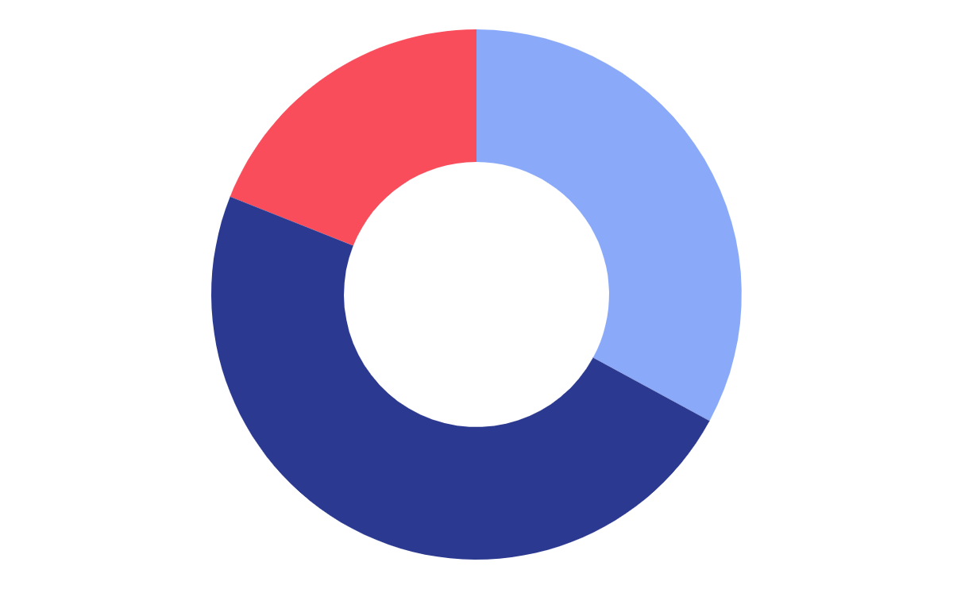
Considerations
Data Cleaning
Remove errors or deal with missing values
Feature Engineering
Feature Selection
Perform de-identification process
Use selective data to mask identifiable information

Slide 17
04
Impacts
How do we measure success?
Does it align with our goals?

Slide 18
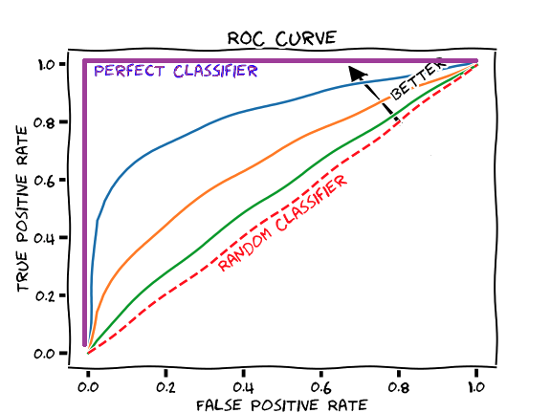
Evaluation KPIs
AUC-ROC Curve
Area under the curve - Receiver Operating Characteristics curve

Slide 19
This project aligns with our business goals
U.S.
Globally
Current efforts on historical examples U.S. citizens
Possible targets globally with your help

Slide 20
05
Stages
What is the current status?
Expected timeline?

Slide 21
Current Status - Data Exploration
Initial Data Report
Data has 38 columns and 26,707 records
Data is in CSV format with full access and available to download
Three columns that contain over 40% of missing values.

Slide 22
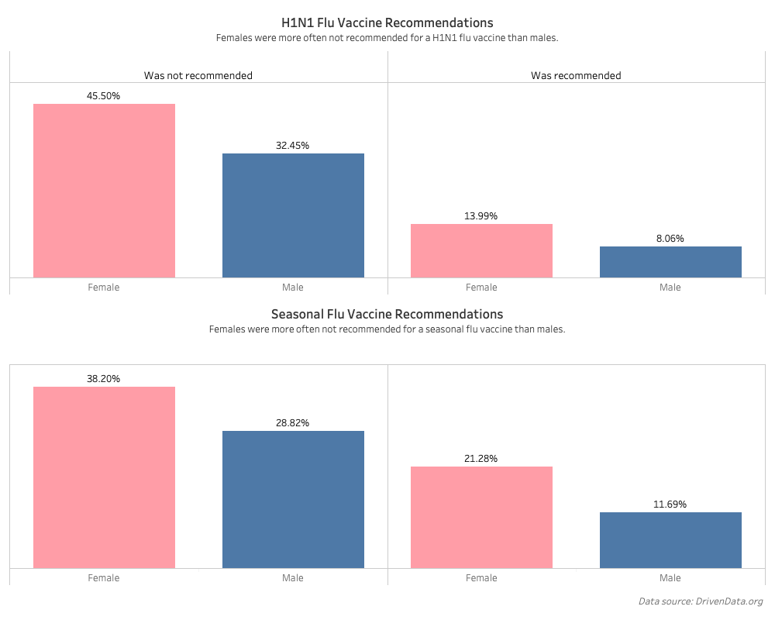

Slide 23
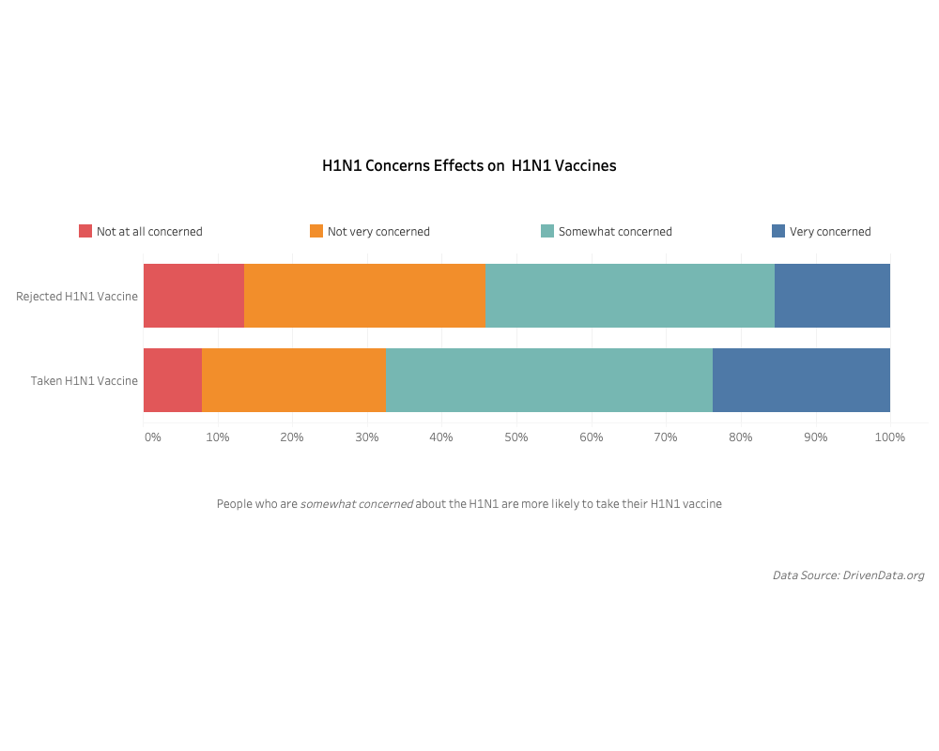

Slide 24
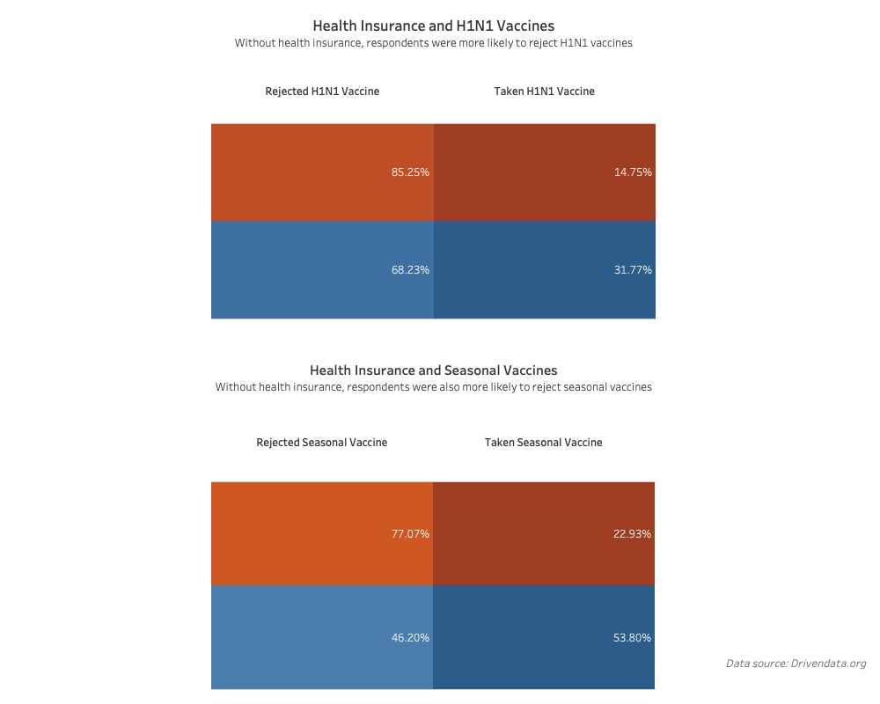

Slide 25
Project Stages
March
April
May
June
Data Cleaning
Modeling
Evaluation
Deployment

Slide 26
Conclusion
06

Slide 27
Summary
This was a proposal for modeling vaccination patterns to predict the likelihood of patients who will defer a vaccine
This project will require a lot of data cleaning and de-identification
This project will help healthcare leaders push for more vaccinations and ensure public health safety

Slide 28
Next Steps
We hope to receive your support in this project as we aimed to start the next stage.
We will continue with data cleaning and explore options for dealing with missing data
Then we will look into the cardinality of each survey question and perform feature engineering for any class imbalance

Slide 29
Thanks
Do you have any questions?
Follow the project updates
Email: nhannguyen@sandiego.edu
Phone #: (510) 338-2534

